Slide 1
LESSON 9.1
Hess’s Law

Slide 2
LESSON GOALS
I can apply Hess’s law to calculate enthalpy changes in multi-step reactions

Slide 3
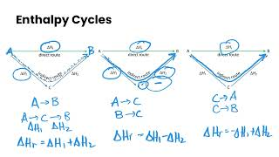
TASK 1: LEARN (MUST DO)
Watch the Hess’s Law video
Complete the guided note

Slide 4
TASK 2: PRACTICE (MUST DO)
With a partner or small group of 3, complete the following questions on the whiteboard
When you are finished, check with another group to see if your answers match!

Slide 5
TASK 3: PRACTICE (SHOULD DO)
Complete the Hess’s Law practice
Check your answers when you are finished (included with practice)!

Slide 6
TASK 4: MASTERY CHECK (MUST DO)
Complete the Hess’s law mastery check (see me when you are ready!)

